Slide 1
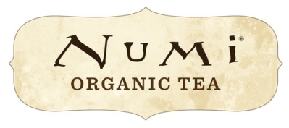
PATH to FINANCING

Slide 2
PATH to FINANCING

Slide 3
PATH to FINANCING

Slide 4
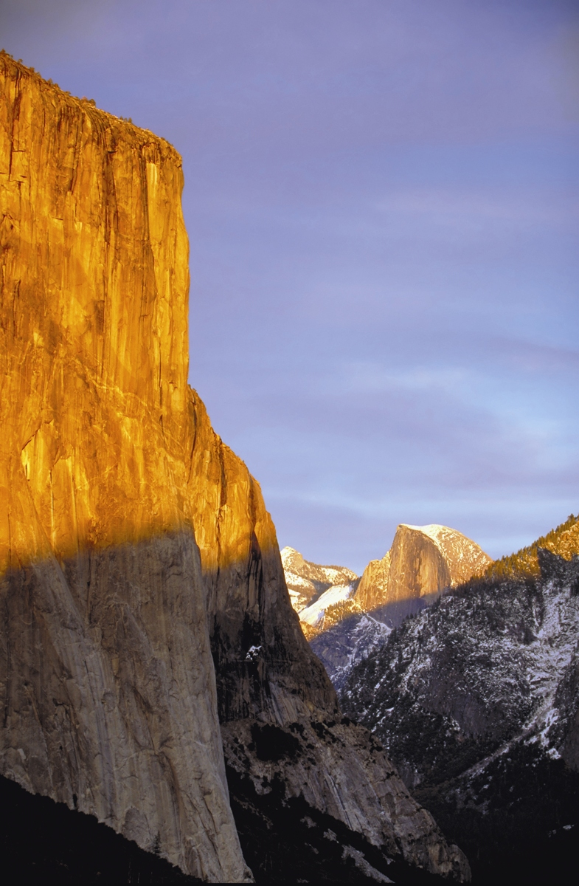
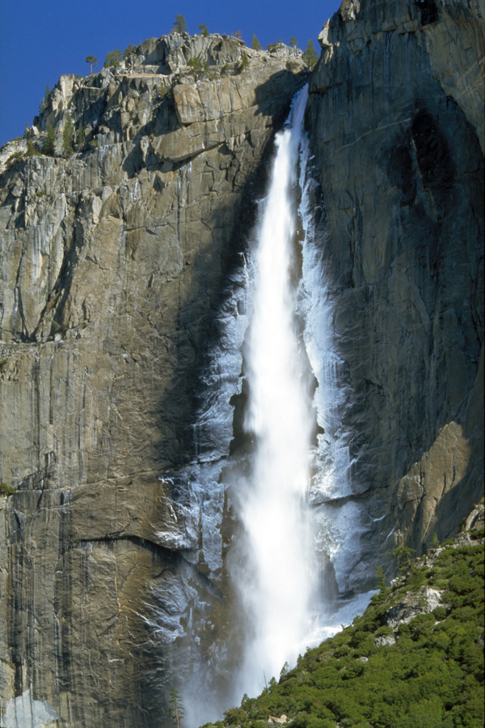

Slide 5
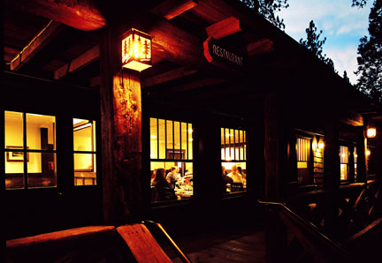
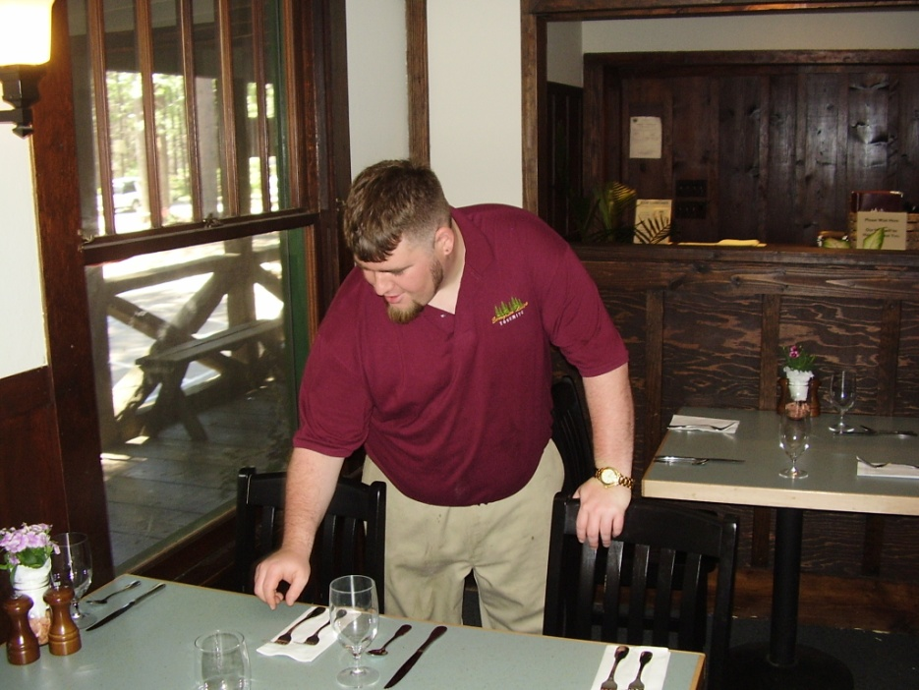
The Evergreen Lodge
A For Profit Social Enterprise…
Historic Yosemite Tourist Resort
Youth Employment Program

Slide 6
Social Enterprise Model
Business Model
Social Program
Develop & Manage Premier Yosemite Destination Resort
Fully Fund Social Program from Lodge Profits
Equity structure
15-20% total return
9% preferred return
60% of excess cash flow
Designed for long term hold with return of capital via refinancing
Support at-risk Bay Area youth in developing stable, rewarding careers and lives by providing
Career-oriented training and work experience
Strong social service support
Multi-faceted outdoor recreational program
Healthy community

Slide 7
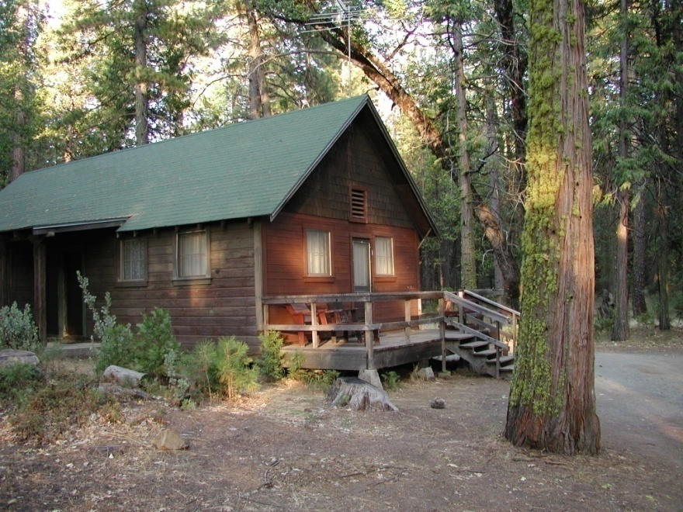
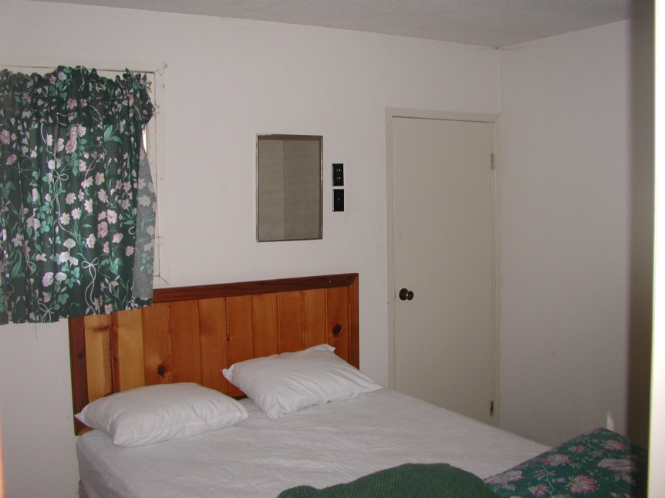
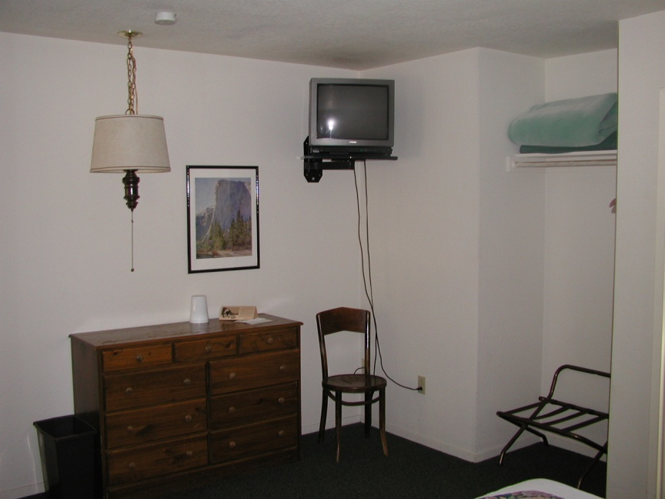
Before Expansion (2002)
18 Cabin
Seasonal
Mom & Pop
Motel

Slide 8
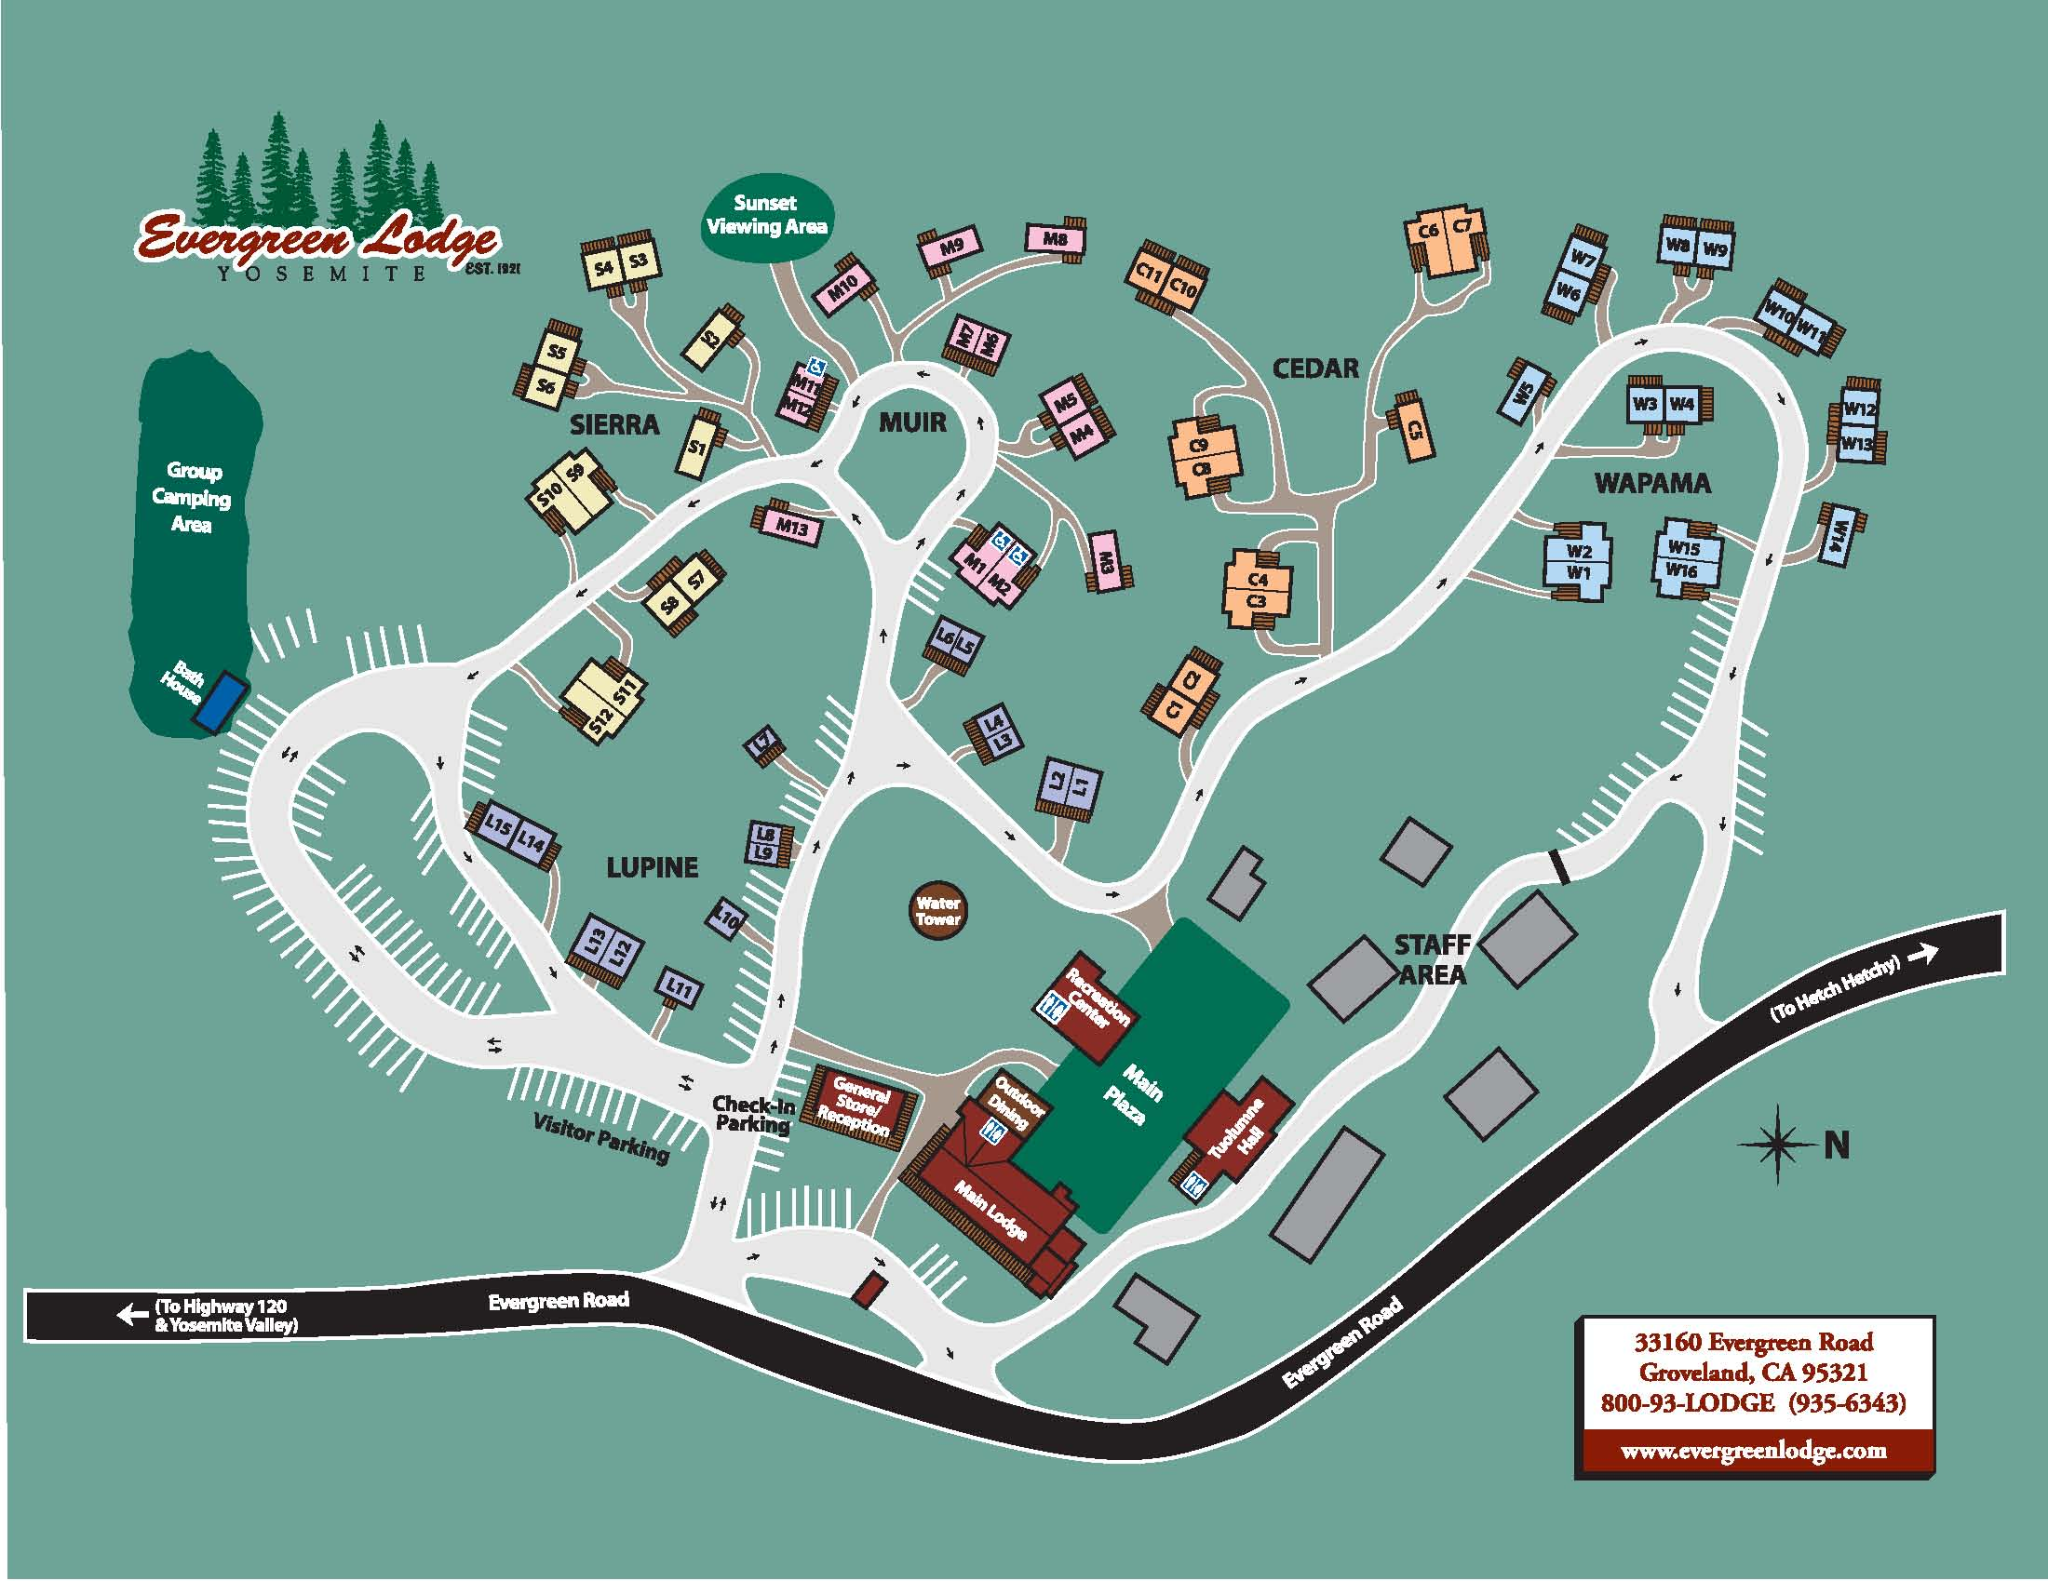
1st Expansion (2004)

Slide 9
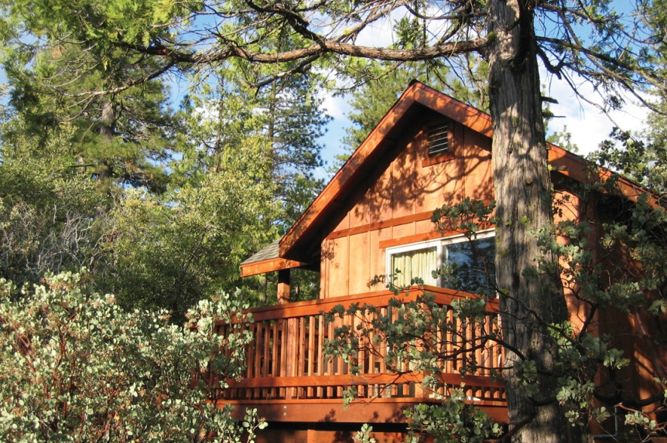
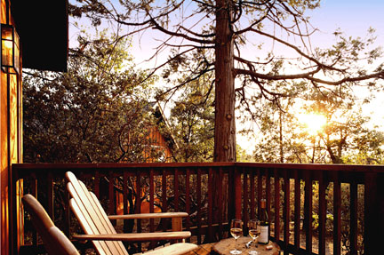
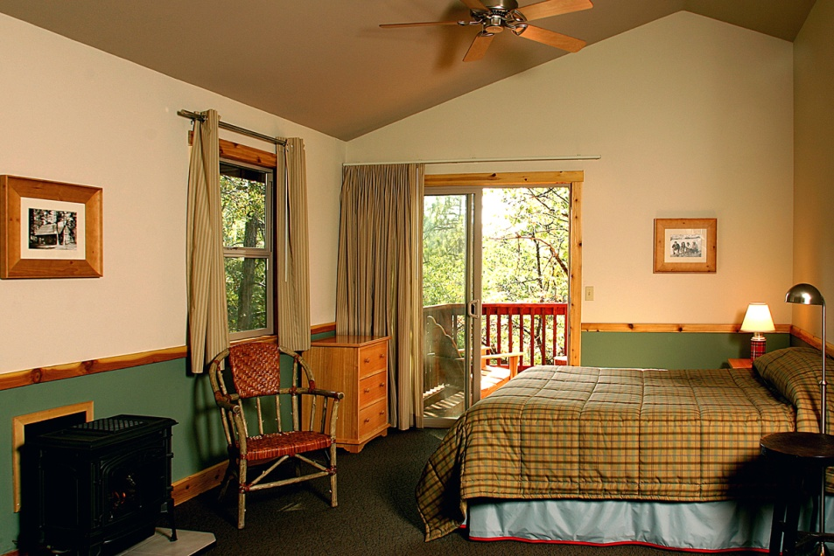
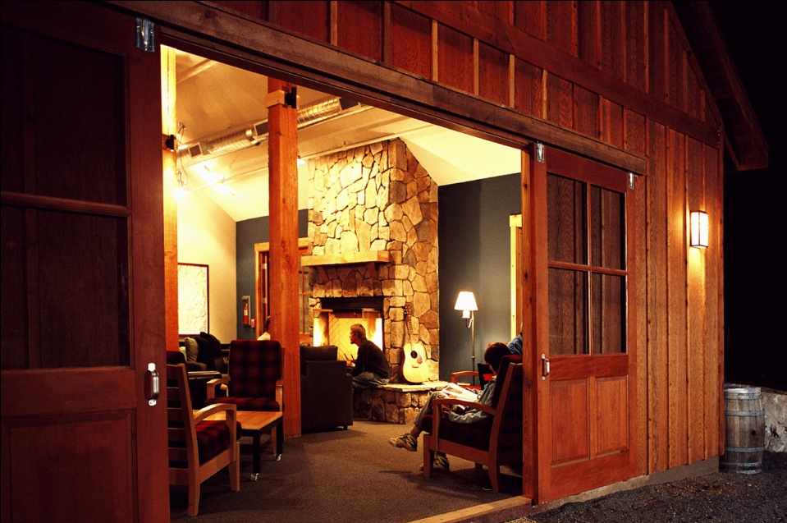
After 1st Expansion

Slide 10
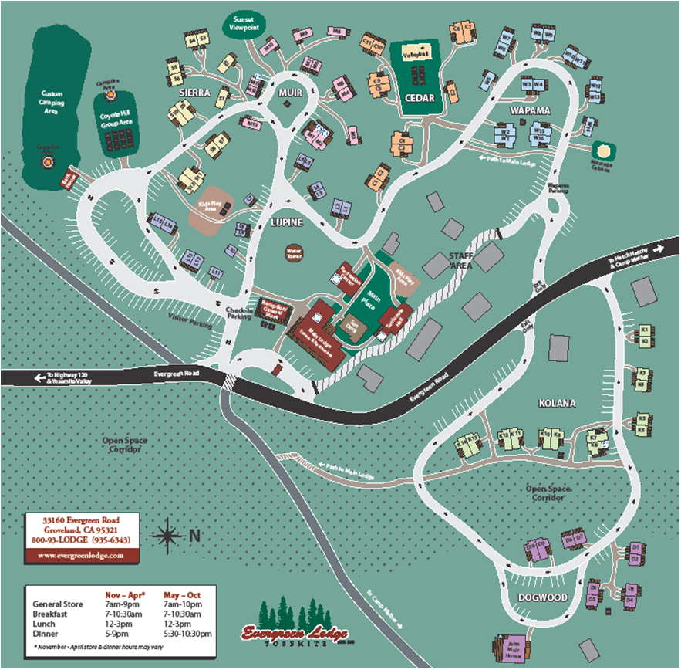
2nd Expansion (2009)

Slide 11
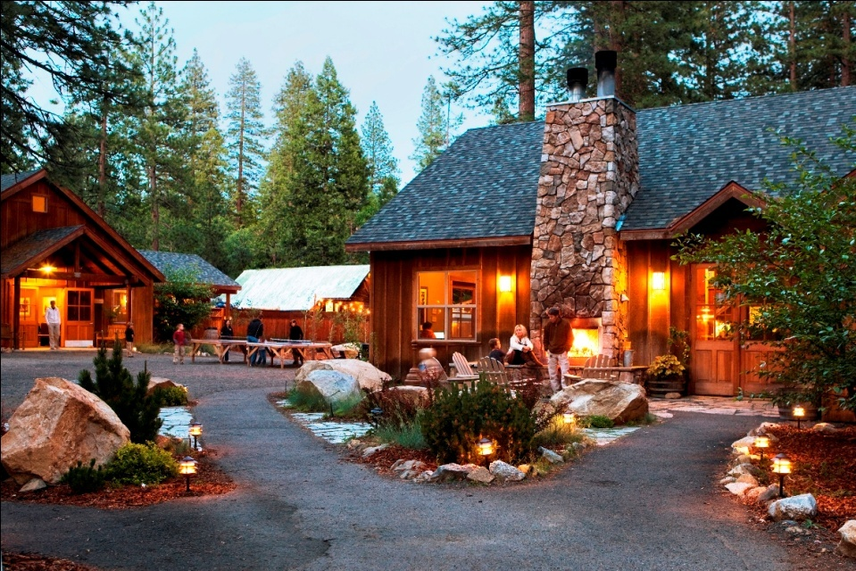
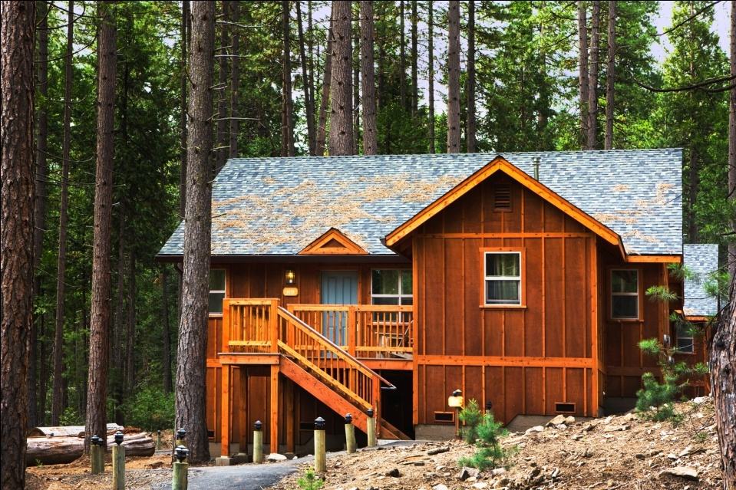
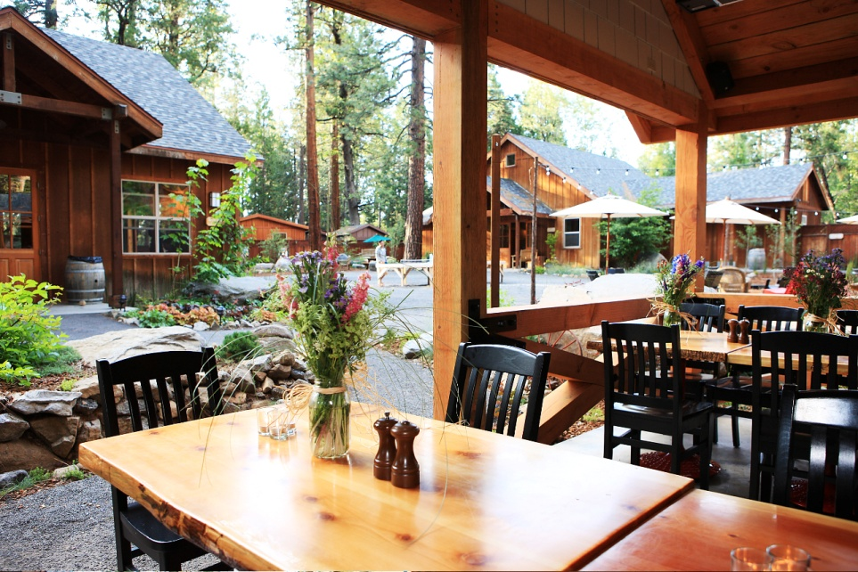
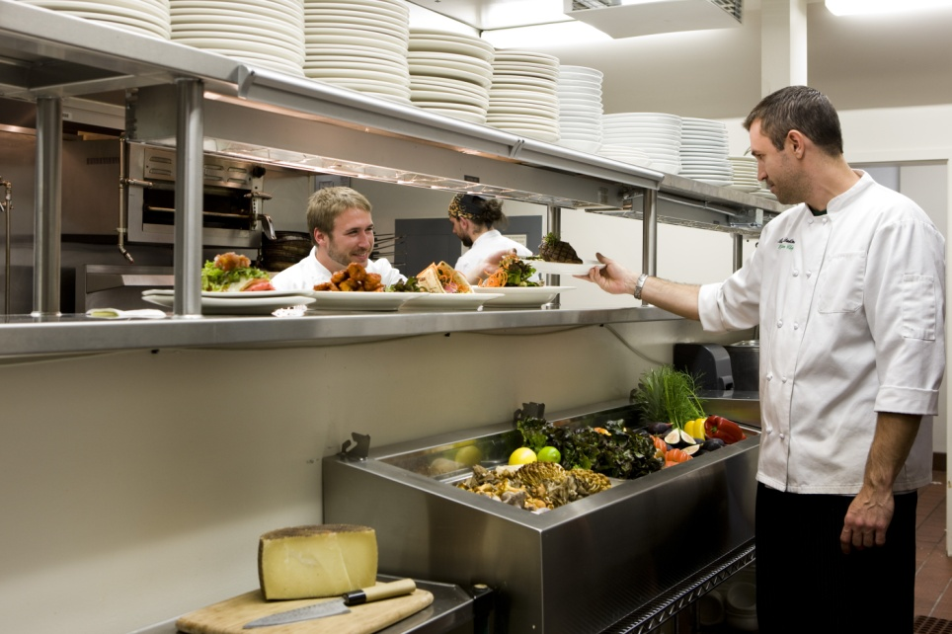
After 2nd Expansion

Slide 12
Post Expansion Business Update
A Frommer’s ‘Favorite.’ ‘Highly Recommended’ by Fodors
Sunset Magazine ‘Best of the West: Hidden Gem’
Lodge Consistently Ahead of Planned Revenue & Profitability
Consistent Growth Throughout Economic Downturn
Consistent, Growing Investor Distributions for Last 6 Years

Slide 13
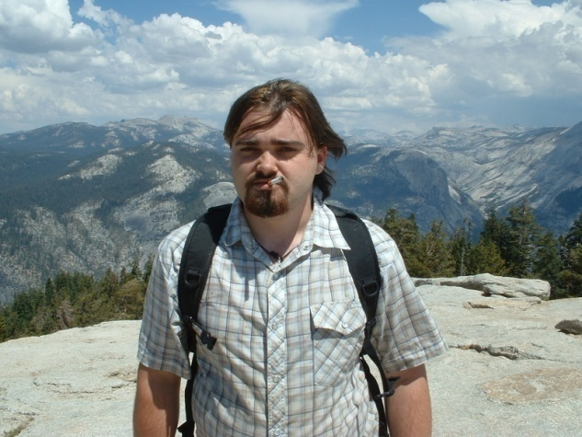
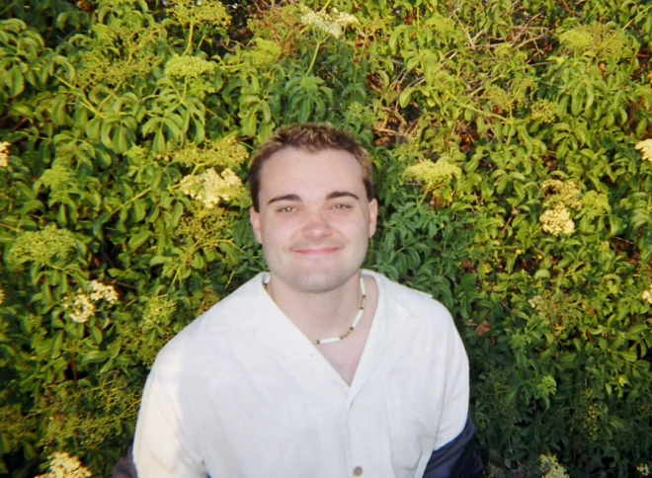
Post Expansion Youth Program Update
Over 125 Young Adults Served to Date
Program Growth from 4 to 20 Served Per Year
Program Fully Funded by Lodge, including Two Full Time Staff
Many Successful Educational and Career-Oriented Transitions into Adulthood

Slide 14
Financing #1 – Acquisition (2001)
$1.5M Total
$500K Equity
$1M Debt
$75K Owners
$150K Foundation PRI
$275K Six Individuals
$10-100K
Progressive minded
Social enterprise or youth interest
$200K Non-Profit Partner
$650K SBA Loan
$100K County Loan Fund
$50K Calvert Loan
Discretionary Fund
No success with Angels Networks, Progressive VC’s or Larger Foundation PRI’s

Slide 15
Financing #2 – 1st Expansion (2003)
$8M Additional
$2.5M Equity
$5.5M Debt
$300K Foundation PRI
$650K Institutional (PCV)
$1.3M Twenty Individuals
$10-300K
$250K Contractors
$4.3M Commercial Loan
USDA B&I Guarantee Program
$1.2M CDBG Funded County Loan

Slide 16
Financing #3 – Cost Overrun (2004)
$1.3M Additional
$500K Equity
$800K Debt
$100K Owners
$400K Existing Investors
$100K CDBG Funded County Loan
$350K SBA Guaranteed Loan
$350K Calvert Loan

Slide 17
Financing #4 – 2nd Expansion (2008)
$4.5M Additional
No Equity
$4.5M Debt
$4.5M RSF Social Finance
Supported by strong cash flows & high debt service coverage
Enabled further scaling of Youth Program

Slide 18
Total Financing
$15.3M Total
$3.5M Equity
$11.8M Debt
$175K Owners
$750K Institutional (PCV)
$525K Foundation PRI
$1.8M 25 Individuals
$250K Contractors
$200K Non-Profit Partner
$1.0M SBA
$4.3M Commercial Loan
USDA B&I Guarantee Program
$1.4M CDBG Funded Loan
$400K Calvert Loan
$4.5M RSF Social Finance

Slide 19
Refinancing (2011)
$15.3M Bank of America Loan
Use of Funds
Terms
$10.5M Replace Existing Debt
$3.6M Return of Investor Capital
Retained ownership
No longer receive preferred dividend
Continued cash flow sharing
$1.2M Capital Improvements
7 Year Loan
20 Year Amortization
4.8% Fixed Rate (via Swap)
Tried to complete through RSF Social Finance but difficult scale/timing

Slide 20
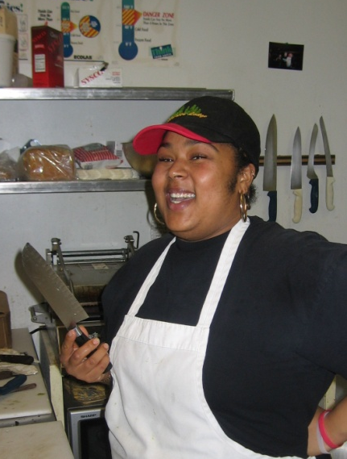
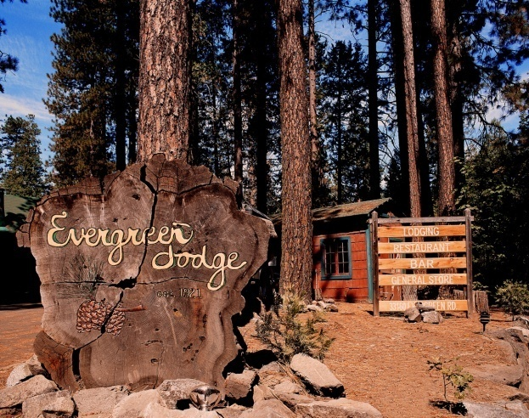
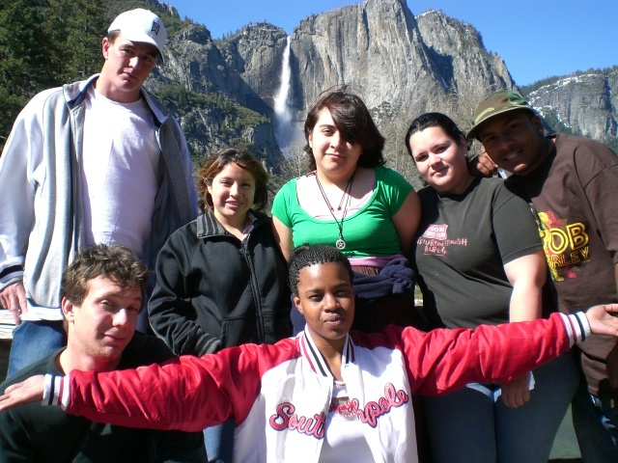
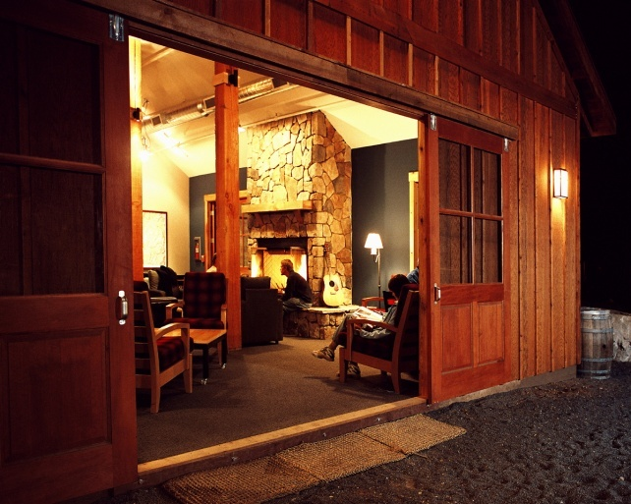
The Model Works
A combination of social and
mainstream capital has enabled
creation of a profitable
for-profit business with an
ongoing social service program
fully funded through one-time investment

Slide 21
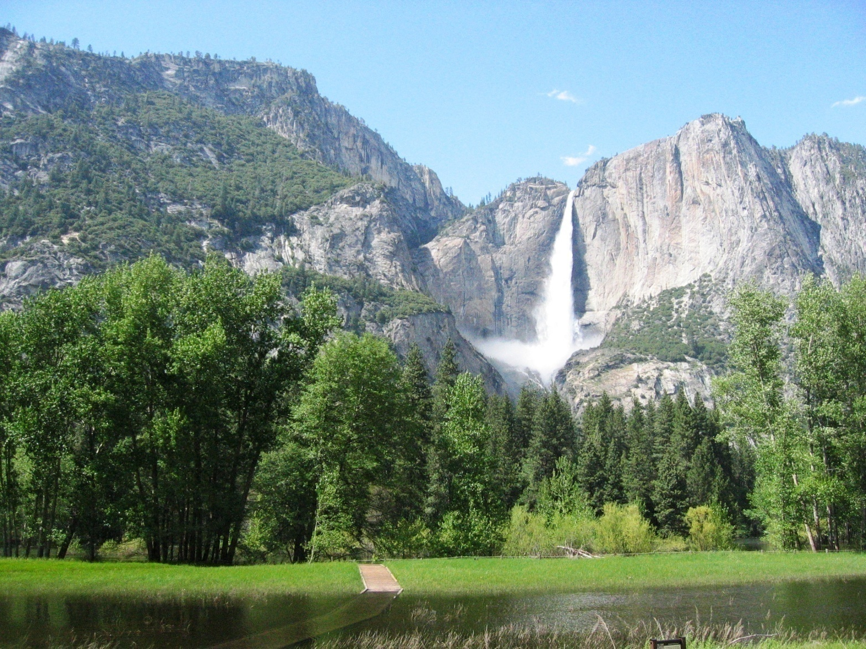
Visit Yosemite!

Slide 22
A GLOBAL COOPERATIVE

Slide 23
Ownership Structure
NICA
2,300
FAMILIES
PERU
7,500
FAMILIES
ETHIOPIA
132,000
FAMILIES
GUATE
1,100
FAMILIES
MEXICO
1,950
FAMILIES
PACHA
CO-OP
100% FARMER-OWNED & FARMER-GOVERNED

Slide 24
Cooperative Model
Farmer-Owned Cooperatives in the U.S.A.
Organic Valley
Ocean Spray
Cabot Creamery
Sunkist
Tillamook
Blue Diamond
Florida’s Natural
… to name a few.
A Successful Business Model

Slide 25
Pachamama Coffee
Mission
To provide customers with premium coffee in the most direct way possible and, in doing so, improve the lives of small-scale farmers and their families.
If you want support farmers, buy directly from farmers.

Slide 26
A Virtuous Circle
Higher value
for organic coffee
Better coffee
for customers
Better life
for family farmers
More sustainable
organic production
Financial and Social Incentives Are Better Aligned

Slide 27
Investment
Incorporated as a California C-Corp with co-op bylaws in 2001.
Launched U.S. Sales in 2006 with member investment:
2005: Membership Shares: $2,500 cash (each) = $12,500
2006: Preferred Shares: $20,000 of coffee (each) = $100,000
2007: Additional Preferred Shares, members: $50,000
2008: Additional Member Loans: $50,000
2011: Unsecured Loan, Untours Foundation: $50,000
Total Investment over 5 years = $262,500
PACHA REMAINS 100% FARMER-OWNED & CONTROLLED

Slide 28
Challenges & Lessons
Traditional investors typically seek fast growth with a clear exit strategy.
Farmers don’t need an exit and generally cannot afford fast growth. Find alternatives.
Grants from multi-lateral organizations, like the World Bank, will not fund operations.
However, they can be a source of funds for information technology investment.
Farmers are poor; investment will be difficult to secure. Invest carefully. Grow slow.
Be creative. Embed incentive plans to invest (like matching funds from foundations).
Keep Overhead Low & Retain Ownership

Slide 29
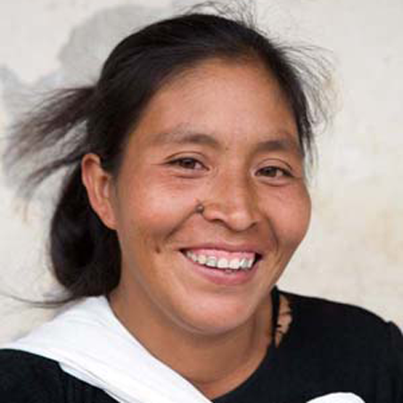
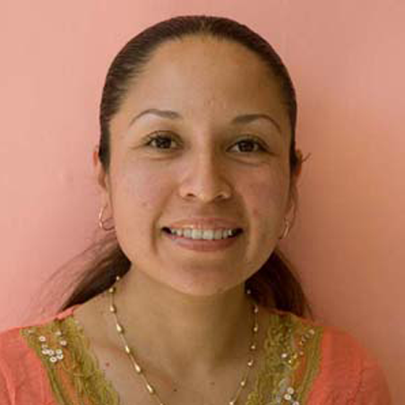
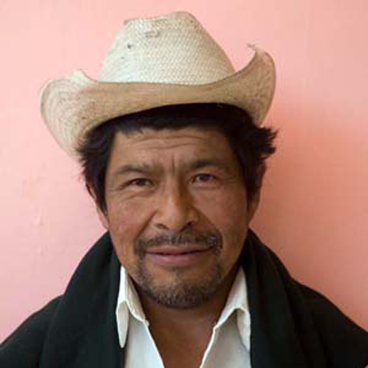
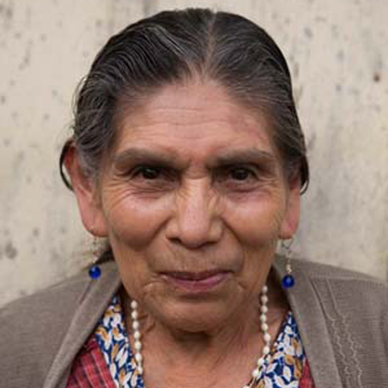
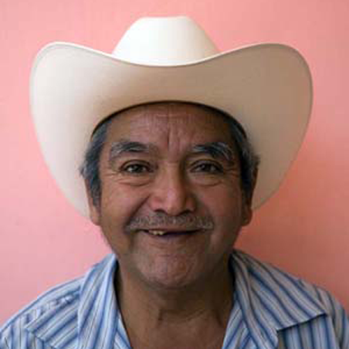
Invest in Family Farmers Around the World.
C.S.A.’s = Micro-Loans + Direct Trade with Farmers.

Slide 30
PATH to FINANCING

